Slide 1
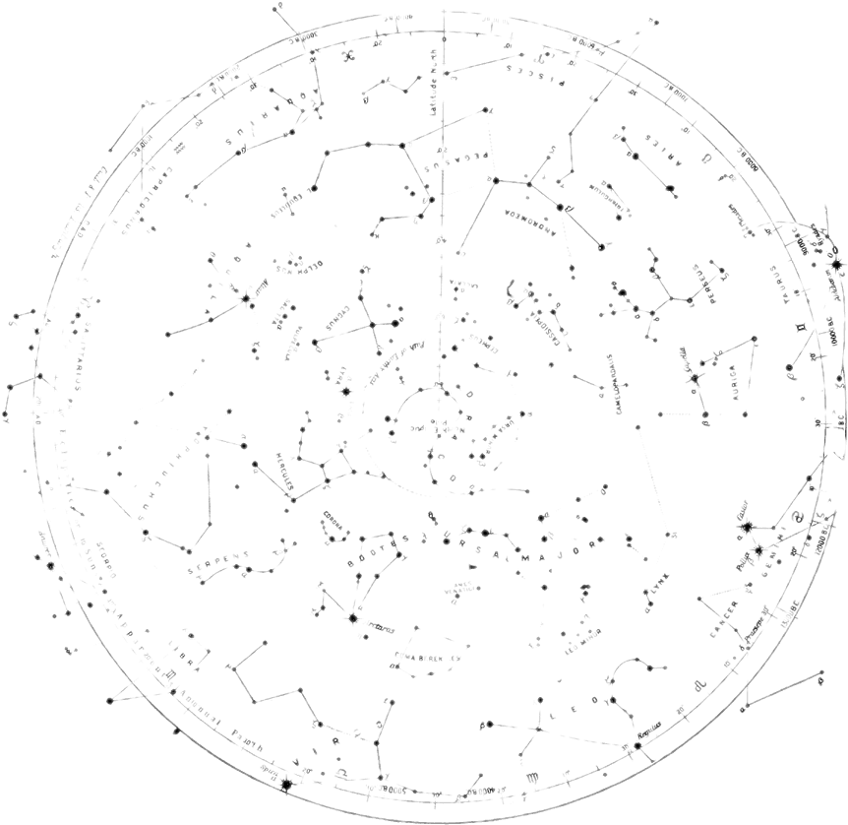

Physics of Rockets
THE SESSION WILL BEGIN SHORTLY
Presented by:
Jacob Lawson

Slide 2

Intro to Avionics and Flight Controllers
Jacob Lawson

Slide 3
What’s the point?
This is the brain of your rocket, how it knows when and where it is and at what point to deploy the parachute. While the USA managed to get to the moon using the computing power of a calculator your rockets will require a lot more to get to 1500m.

Slide 4
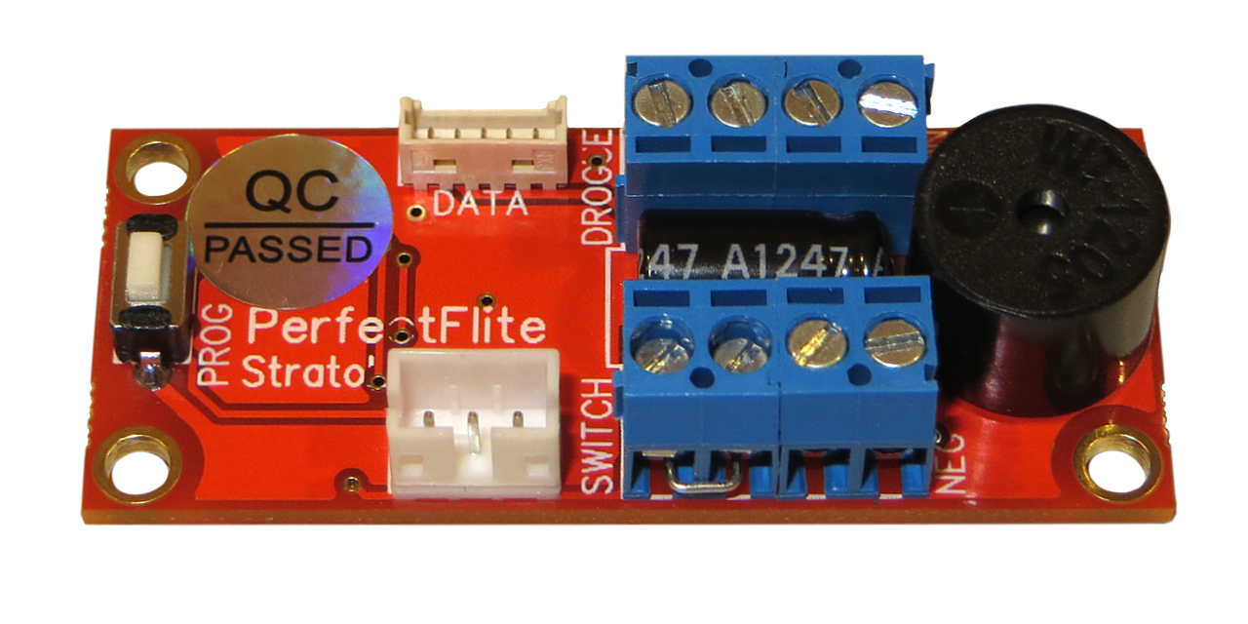
Pre-Built Options
PerfectFlite Stratologger CF
Want to do zero work on your avionics?
Buy a prebuilt
No circuit designing
No coding
No fuss

Slide 5
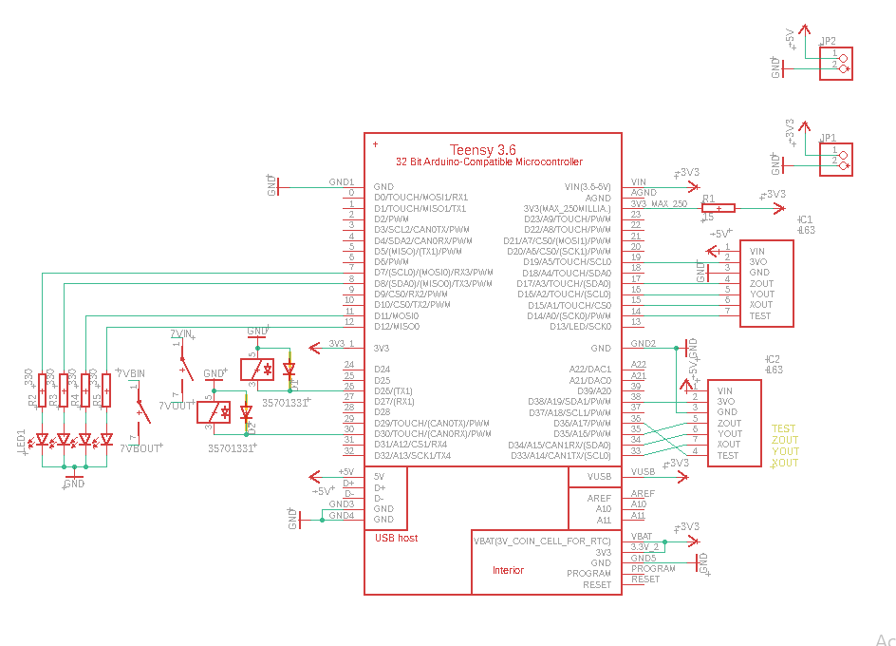
Custom Built
By designing our own circuit using off the shelf components we can create a far more intelligent avionics board
Shown here is an early version of the board schematic for our rocket VESNA

Slide 6
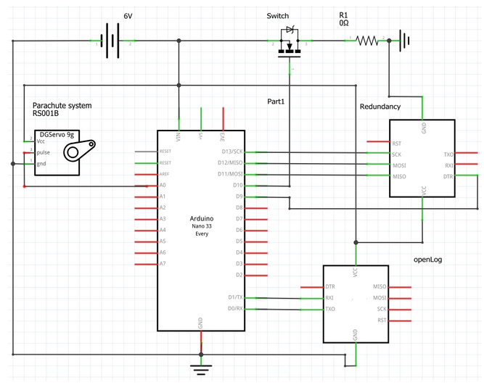
So what are you going to be building?

Slide 7

A custom microcontroller power FC
Capable of
Power on
Parachute deployment
Gyroscope measurements
Altitude measurements
https://www.youtube.com/watch?v=R5yhD7-Nu-k
https://www.youtube.com/watch?v=7PF2xnGsxDs&t=5s

Slide 8
How are you going to learn how to build this?

Slide 9
Through the follow key stages
1: Introduction to circuitry, Arduino coding and power management
2: Introduction to designing a Flight Controller schematic in Autodesk Eagle
3: Creating your avionics board in Autodesk Eagle
4: Programming your Flight Controller

Slide 10

1: Introduction to circuitry, Arduino coding and power management
This training session will cover the basics
Building a basic circuit with an online simulator
How to make your circuit components interact with each other using Arduino
An explanation on power management and stability

Slide 11

2: Introduction to designing a Flight Controller schematic in Autodesk Eagle
Designing a circuit using individual components can be daunting, but Eagle simplifies it right down, and we will explain
Finding components for your circuit
Ensuring pin requirements of your components are met
How to be efficient with your design

Slide 12
3: Creating your avionics board in Autodesk Eagle
We will then take your schematics and use them to design a PCB board
Sizing out your board
Auto-routing and doing yourself
Creating a compact and safe design

Slide 13

4: Programming your Flight Controller
Then its time to write your code. This is what makes your rocket’s avionics truly intelligent and as such it can end up being what makes or breaks your rocket.
Accelerometer integration
Parachute launching
A successful flight

Slide 14
What will you need?
1: Introduction to circuitry, Arduino coding and power management
Online Arduino simulator
E.g. TinkerCAD
2: Introduction to designing a Flight Controller schematic in Autodesk Eagle
Autodesk Eagle
3: Creating your avionics board in Autodesk Eagle
Autodesk Eagle
4: Programming your Flight Controller
Arduino coding program
All required programs are subject to change. We will make sure you are told which programs you’ll definitely need the week beforehand in the lesson announcement email.

Slide 15
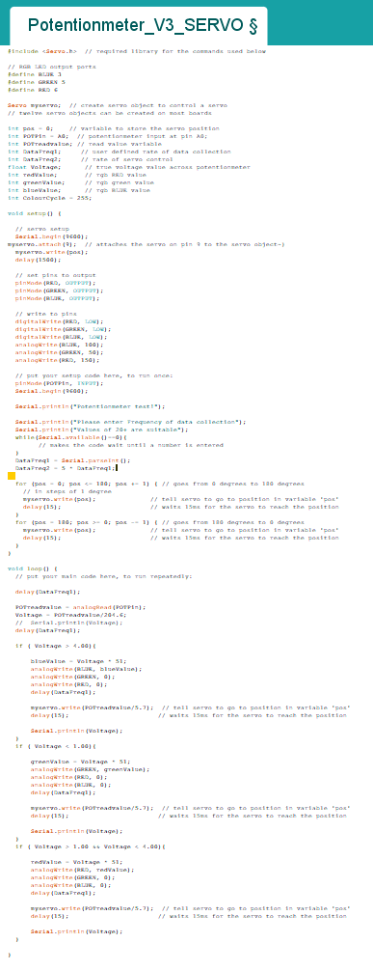
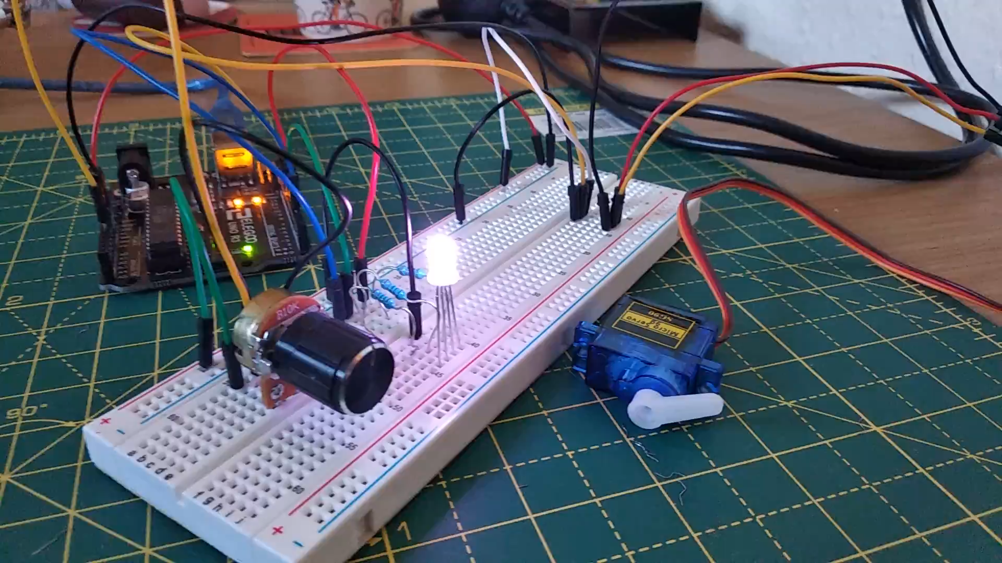
Arduino coding

Slide 16
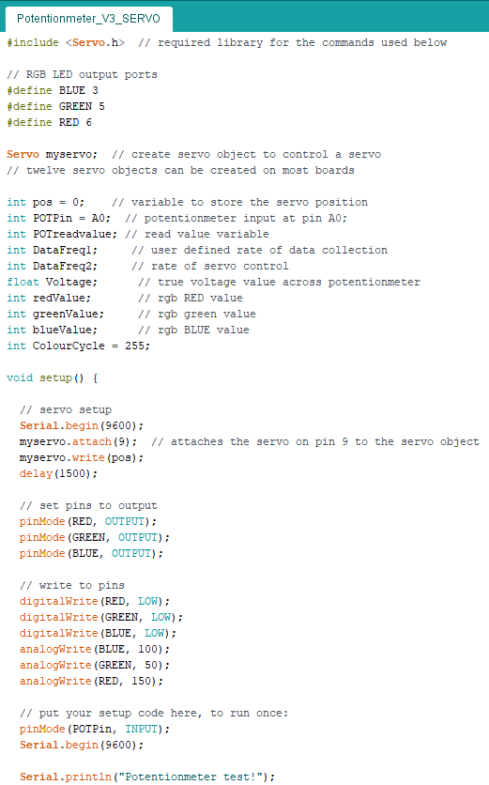
Know your pins
Your system needs to except data from multiple inputs and control multiple outputs, all in a fraction of a second.

Slide 17
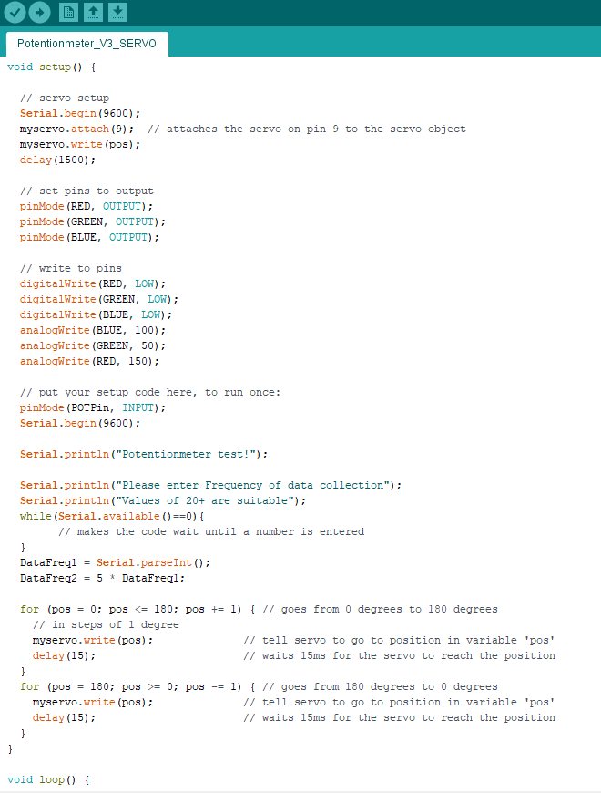
Variable conditions
Your launch site is yet to be decided, so make sure to use user defined variables. This way your avionics can be easily modified

Slide 18
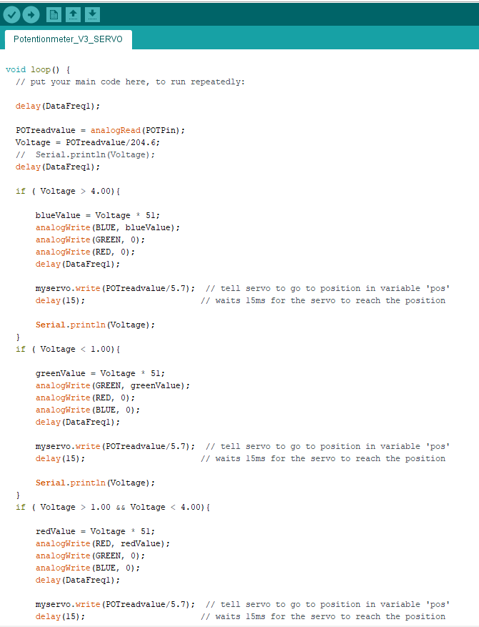
Not just like the simulations
You can simulate your flight on OpenRocket as many times as you like, its still not the real thing.
Your avionics must be able to use sensor data to decide when to change state.
There’s no point releasing your parachute before apogee just because the expected time to apogee has passed.

Slide 19
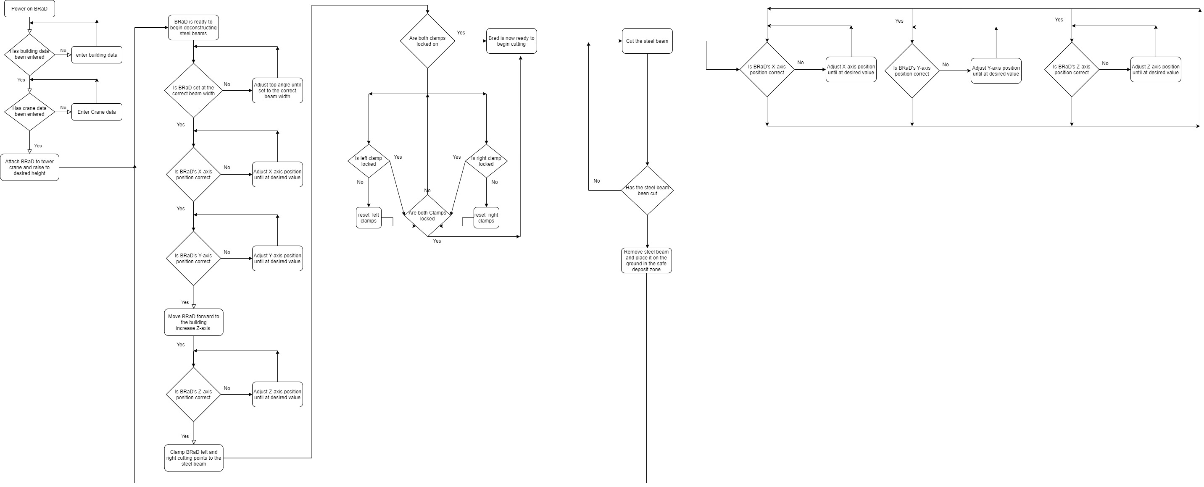
Coding Flow Diagrams
It helps to layout your code before writing it
https://app.diagrams.net/
Draw.io allows you to create these easily online

Slide 20
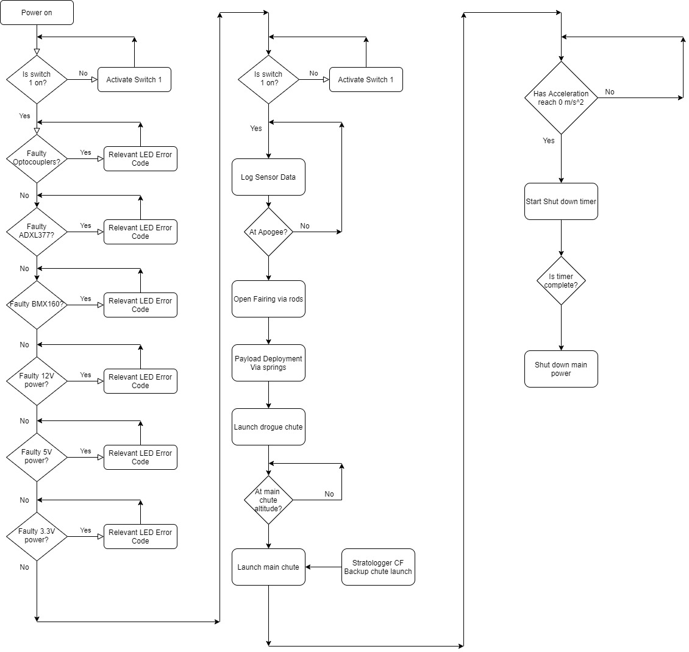
A Basic Flow Diagram For VESNA

Slide 21
Task
Action Statement
Use Draw.io to create a coding diagram of the payload you created at the end of Wednesday’s design session.
You don’t need to overcomplicate it. Just the general outline of your data gathering process.
Loop back
NO: Condition is false
Condition Function
YES: Condition is true

